Slide 1


Yasir Mehaisi
19/Sep/2025

Slide 2

Outline
Executive Summary
Introduction
Methodology
Results
Conclusion
Appendix

Slide 3
Executive Summary
Objective: Predict whether the SpaceX Falcon 9 first stage will land successfully, helping estimate launch reusability and cost savings.
Data Sources: SpaceX REST API, Wikipedia launch records.
Approach:
Collected & cleaned launch data.
Explored success rates across payloads, launch sites, orbits, and booster versions.
Key Findings:
Landing success is strongly influenced by payload mass, booster version, and launch site.
All classification models have achieved the same predictive accuracy (~83%).

Slide 4
Introduction
SpaceX launches cost ~$62M, but the first stage recovery can save ~$6M per launch.
Predicting if the first stage will land successfully helps assess reusability and reduce costs.
Goal: Build a predictive model to determine the likelihood of first stage landing success.

Slide 5

Section 1

Slide 6
Methodology
Executive Summary
Data collection methodology:
Data was collected from Space X REST API and Wikipedia web scraping.
Perform data wrangling
Cleaned, merged, and standardized datasets, handling null values and formatting inconsistencies..
Perform exploratory data analysis (EDA) using visualization and SQL
Perform interactive visual analytics using Folium and Plotly Dash
Perform predictive analysis using classification models
Trained with cross-validation, tuned hyper parameters, and evaluated using accuracy, precision, recall, and F1-score.

Slide 7
Pandas Dataframe
Data Extraction
Space X REST API
Web Scraping
Wikipedia Launch Records
Data Collection
SpaceX REST API (launch details, payloads, landing outcomes)
Wikipedia web scraping (additional launch records, rocket info)
Tools used: Python, Pandas, BeautifulSoup, SQL, Jupyter Notebooks

Slide 8
Data Collection – SpaceX API
Space X REST API launch data JSON
API Requests
(Python Requests)
Pandas DataFrame
(Data Parsing)
JSON Response
(Raw Launch Data)
Used API calls in Python (requests, json) to retrieve structured data.
SpaceX API calls notebook

Slide 9
Data Collection - Scraping
Wikipedia URL
[HTTP Request]
(Requests)
[Parse HTML]
(BeautifulSoup)
[Find Launch Table]
<table> tags
[Extract Rows & Columns]
<tr>, <td> elements
[Structured Data] → Pandas DataFrame
Used web scraping with BeautifulSoup for Wikipedia tables.
Web Scraping Notebook

Slide 10
Data Wrangling
Extracted Pandas DataFrame
Data Cleaning
(Remove nulls, duplicates,
standardize categories)
Data Transformation
(Target variable creation,
normalization, encoding)
Data Integration & Storage
(Merge datasets into SQL DB)
Final Analytical Dataset
(Ready for EDA & Modeling)
Removed duplicates, null values, and inconsistent entries.
Standardized target variable: Landing Outcome → Success (1) / Failure (0).
Engineered features: orbit type, payload mass, booster version, launch site.
Stored intermediate data in SQL database for querying.
You need to present your data wrangling process using key phrases and flowcharts
Data Wrangling SQLite notebook

Slide 11
EDA with Data Visualization
Catplot (Categorical Plot): To compare categorical variables such as launch site and booster version against landing outcomes. Example: Showed which launch sites had the highest landing success rates.
Bar Chart: To visualize the frequency distribution of categorical variables. Example: Number of successful vs failed landings across different booster versions and orbit types.
Scatter Plot: To examine the relationship between two continuous variables (e.g., payload mass vs. landing success).Example: Identified how heavier payloads reduce the probability of successful landings.
Line Chart: To observe trends over time. Example: Success rate progression across years, showing improvement in newer launchesAdd the GitHub URL of your completed EDA with data visualization notebook, as an external reference and peer-review purpose
EDA Visualisaion Notebook

Slide 12
EDA with SQL
Retrieved total number of launches from SpaceX dataset.
Counted successful vs. failed landings.
Queried distinct launch sites and their usage frequency.
Found most common booster versions used in launches.
Calculated average payload mass per launch site.
Analyzed landing success rate by orbit type.
Identified top 5 payload customers (e.g., NASA, SES, Iridium).
Queried trend of successful landings by year.
Examined correlation between booster version and landing success.
EDA with SQL Notebook

Slide 13
Build an Interactive Map with Folium Notebook
Build an Interactive Map with Folium
Object Type | Purpose
Markers | Identify launch sites on the map.
Circles | Represent landing outcomes (success/failure) with color-coded markers.
Lines | Show distance between launch sites and landing zones.
Popups | Provide extra info when clicking (site name, outcome, payload).

Slide 14
Build a Dashboard with Plotly Dash
Plot / Interaction | Description | Purpose / Why Added
Pie Chart | Shows the proportion of successful vs. failed launches per launch site. | Provides a quick overview of success rates across different sites; helps identify which sites are more reliable.
Scatter Plot | Displays payload mass vs. landing outcome, with markers colored by success/failure. | Allows exploration of the relationship between payload size and landing success; helps identify payload thresholds where success probability is higher.
Dropdown Filter (Launch Site) | User can select a specific launch site to filter both charts. | Enables focused analysis of performance by site; avoids clutter from multiple sites.
Slider (Payload Mass Range) | Adjusts payload mass range to filter scatter plot points. | Provides interactive exploration of how payload weight affects landing success; allows dynamic comparisons.
Plotly Dash Lab Notebook

Slide 15
Predictive Analysis (Classification)
Data Preparation:
Split data into training (80%) and test (20%) sets.
Standardized/normalized features where needed.
Model Building Trained multiple classification models:
Logistic Regression
K-Nearest Neighbors (KNN)
Support Vector Machine (SVM)
Decision TreeModel
Evaluation:
Accuracy
Confusion Matrix
Model Improvement
Performed Grid Search / Hyperparameter Tuning (e.g., k-value for KNN, max depth for Decision Tree, C parameter for SVM).
Best Performing Model
All classification models have performed the same with an overall accuracy of ~83.3%.

Slide 16
Predictive Analysis (Classification) Notebook
Predictive Analysis (Classification)
Data Preparation
Train-Test Split
Model Evaluation
Logistic Regression
Model Improvement
Grid Search (Tuning)
Feature Scaling
KNN
SVM
Decision Tree
Best Performing Model
Decision Tree (~95%)
Model Building
Accuracy
Confusion Matrix

Slide 17
Results
Exploratory Data Analysis (EDA) Results:
Landing Success Rate by Launch Site: certain sites like KSC LC-39A had higher success rates vs. CCAFS SLC-40.
Payload Mass vs. Landing Success: success decreases for very heavy payloads (> 10,000 kg).
Booster Version vs. Success: newer versions (Block 5) showed much higher success than older ones.

Slide 18
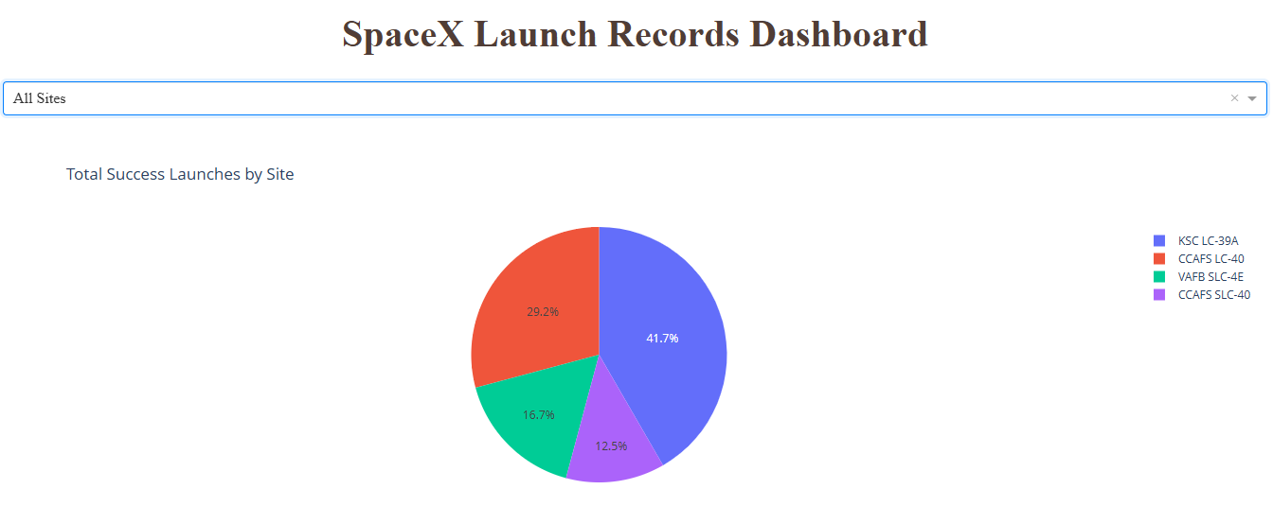
Results

Slide 19
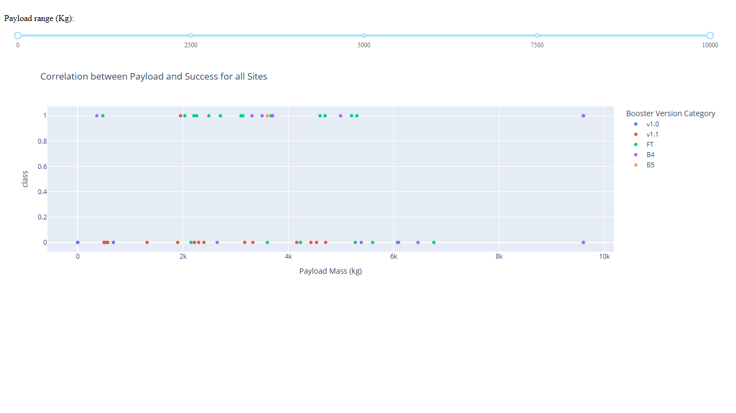
Results

Slide 20
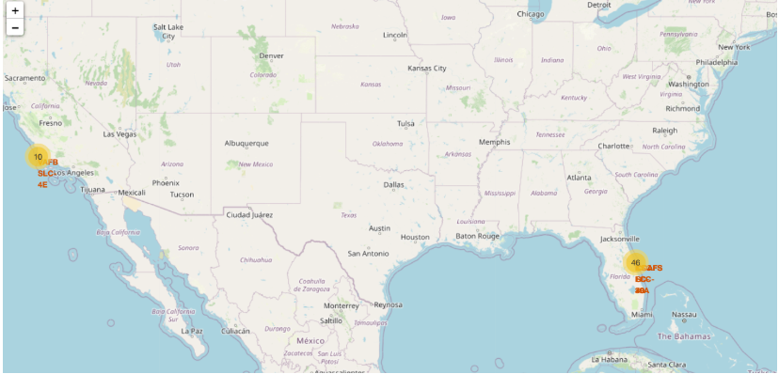
Results

Slide 21
Results
Predictive Analysis Results
Models Compared:
Logistic Regression
SVM
KNN
Decision Tree
Metrics to Present:
Accuracy
Confusion Matrix
Key Findings:
All classification models have performed the same with an overall accuracy of ~83.3%.
The symmetric accuracy is probably due to the small size of dataset is and fewer values are considered

Slide 22

Section 2

Slide 23
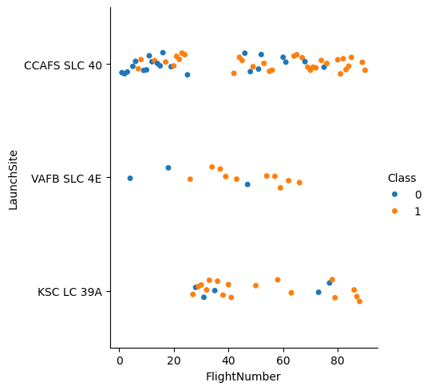
Flight Number vs. Launch Site
The category plot shows the relationship between Flight Number and Launch Site and how they would affect the launch outcome.
It depicts a tendency to failure for low flight numbers and vice versa; which suggests a Proportional correlation between flight number and launch site.
Certain sites like KSC LC-39A had higher success rates vs. CCAFS SLC-40

Slide 24
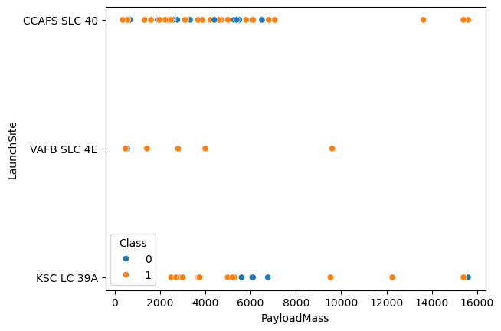
Payload vs. Launch Site
The scatter plot shows the relationship between Payload Mass and Launch Site and an overlay for the outcome of the launch
The Success decreases for very heavy payloads (> 10,000 kg), suggesting an inverse correlation between payload Mass and Success.

Slide 25
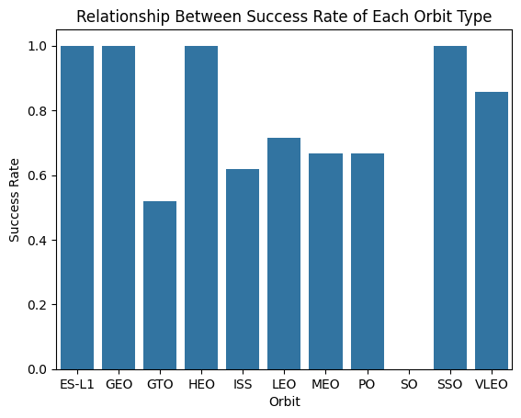
Success Rate vs. Orbit Type
The bar chart illustrate the Success Rate of each orbit
ES-L1, GEO, HEO and SSO had the maximum success rate of 100%, while GTO had the least success rate of about 50%

Slide 26
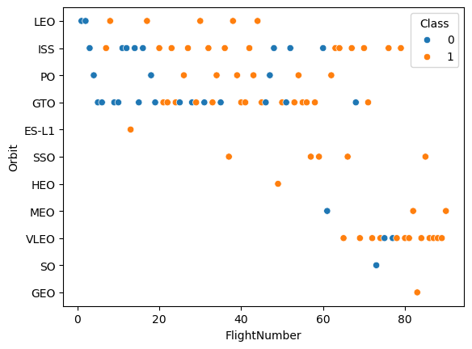
Flight Number vs. Orbit Type
The chart shows a scatter point of Flight number vs. Orbit type over launching outcome
In certain orbits like LEO orbit, success seems to be related to the number of flights.

Slide 27
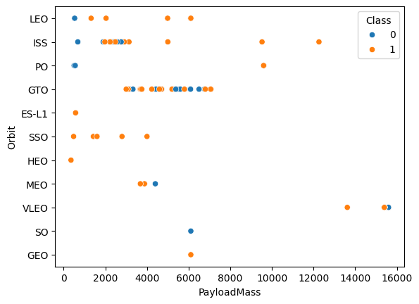
Payload vs. Orbit Type
The Chart shows a scatter point of payload vs. orbit type with success outcome overlay.
With heavy payloads the successful landing or positive landing rate are more for Polar, LEO and ISS.

Slide 28
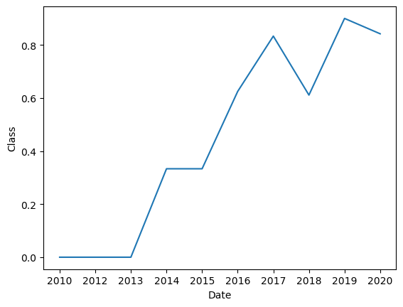
Launch Success Yearly Trend
The figure shows a line chart of yearly average success rate.
Significant up ward trend can be noticed between 2013 and 2020

Slide 29
All Launch Site Names
The table represent the names of launch sites:
CCAFS LC-40
VAFB SLC-4E
KSC LC-39A
CCAFS SLC-40
Launch_Site
CCAFS LC-40
VAFB SLC-4E
KSC LC-39A
CCAFS SLC-40

Slide 30
Launch Site Names Begin with 'CCA'
Date | Time (UTC) | Booster_Version | Launch_Site | Payload | PAYLOAD_MASS__KG_ | Orbit | Customer | Mission_Outcome | Landing_Outcome
2010-06-04 | 18:45:00 | F9 v1.0 B0003 | CCAFS LC-40 | Dragon Spacecraft Qualification Unit | 0 | LEO | SpaceX | Success | Failure (parachute)
2010-12-08 | 15:43:00 | F9 v1.0 B0004 | CCAFS LC-40 | Dragon demo flight C1, two CubeSats, barrel of Brouere cheese | 0 | LEO (ISS) | NASA (COTS) NRO | Success | Failure (parachute)
2012-05-22 | 7:44:00 | F9 v1.0 B0005 | CCAFS LC-40 | Dragon demo flight C2 | 525 | LEO (ISS) | NASA (COTS) | Success | No attempt
2012-10-08 | 0:35:00 | F9 v1.0 B0006 | CCAFS LC-40 | SpaceX CRS-1 | 500 | LEO (ISS) | NASA (CRS) | Success | No attempt
2013-03-01 | 15:10:00 | F9 v1.0 B0007 | CCAFS LC-40 | SpaceX CRS-2 | 677 | LEO (ISS) | NASA (CRS) | Success | No attempt
The table depicts 5 records of launching sites with names begins with “CCA”.

Slide 31
Total Payload Mass
The figure shows the result of the calculated the total payload carried by boosters from NASA
It is found to be 45596 Kg approximately
SUM(PAYLOAD_MASS__KG_)
45596

Slide 32
Average Payload Mass by F9 v1.1
AVG(PAYLOAD_MASS__KG_)
2928.4
The figure shows the results of the calculated average payload mass carried by booster version F9 v1.1
It is found to be 2928.4 approximately

Slide 33
First Successful Ground Landing Date
Date | Time (UTC) | Booster_Version | Launch_Site | Payload | PAYLOAD_MASS__KG_ | Orbit | Customer | Mission_Outcome | Landing_Outcome | MIN(Date)
2015-12-22 | 1:29:00 | F9 FT B1019 | CCAFS LC-40 | OG2 Mission 2 11 Orbcomm-OG2 satellites | 2034 | LEO | Orbcomm | Success | Success (ground pad) | 2015-12-22
The table shows the first successful landing outcome on ground pad

Slide 34
Successful Drone Ship Landing with Payload between 4000 and 6000
The figure lists the names of boosters which have successfully landed on drone ship and had payload mass greater than 4000 but less than 6000
Booster_Version
F9 FT B1022
F9 FT B1026
F9 FT B1021.2
F9 FT B1031.2

Slide 35
Total Number of Successful and Failure Mission Outcomes
Mission_Outcome | COUNT(Mission_Outcome)
Failure (in flight) | 1
Success | 98
Success | 1
Success (payload status unclear) | 1
The table depicts the total number of successful and failure mission outcomes

Slide 36
Boosters Carried Maximum Payload
The figure lists the names of the booster which have carried the maximum payload mass.
Booster_Version
F9 B5 B1048.4
F9 B5 B1049.4
F9 B5 B1051.3
F9 B5 B1056.4
F9 B5 B1048.5
F9 B5 B1051.4
F9 B5 B1049.5
F9 B5 B1060.2
F9 B5 B1058.3
F9 B5 B1051.6
F9 B5 B1060.3
F9 B5 B1049.7

Slide 37
2015 Launch Records
MONTH | Landing_Outcome | Booster_Version | Launch_Site
01 | Failure (drone ship) | F9 v1.1 B1012 | CCAFS LC-40
04 | Failure (drone ship) | F9 v1.1 B1015 | CCAFS LC-40
The table lists the failed Landing Outcomes in drone ship, their booster versions, and launch site names for in year 2015

Slide 38
Rank Landing Outcomes Between 2010-06-04 and 2017-03-20
Landing_Outcome | COUNT(Landing_outcome)
Precluded (drone ship) | 1
Failure (parachute) | 2
Uncontrolled (ocean) | 2
Controlled (ocean) | 3
Success (ground pad) | 3
Failure (drone ship) | 5
Success (drone ship) | 5
No attempt | 10
The table shows the count of landing outcomes (such as Failure (drone ship) or Success (ground pad)) between the date 2010-06-04 and 2017-03-20, in descending order

Slide 39

Section 3

Slide 40
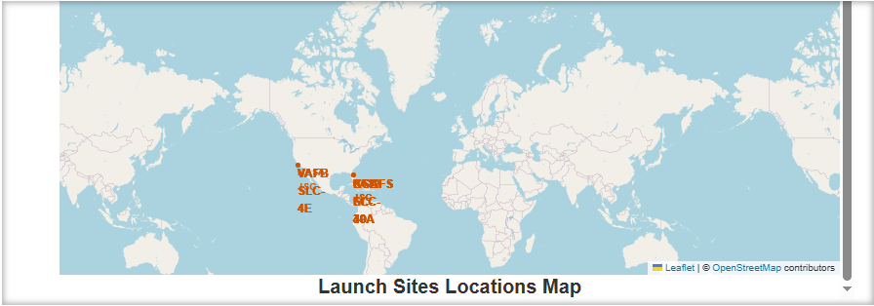
Launch Sites Location Map
The map shows launch sites locations
Findings:
All launch sites in proximity to the Equator line.
All launch sites in very close proximity to the coast.

Slide 41
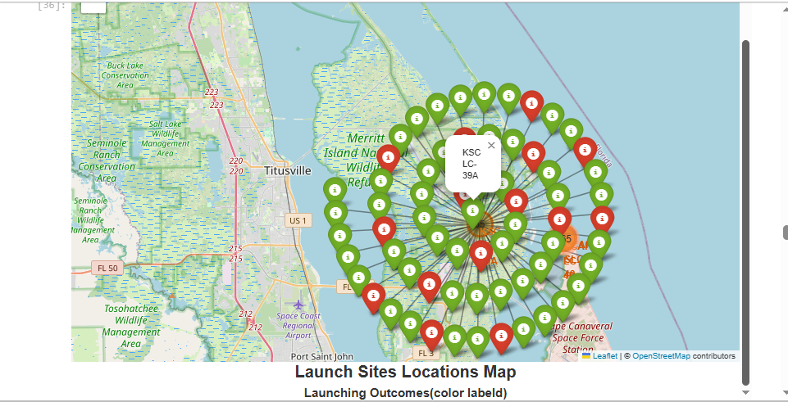
Launching Outcomes (Color Labeld)
The map show the color-labeled launch outcomes.
Findings:
KSC LC-39A launch site seems to have relatively higher success rate.

Slide 42
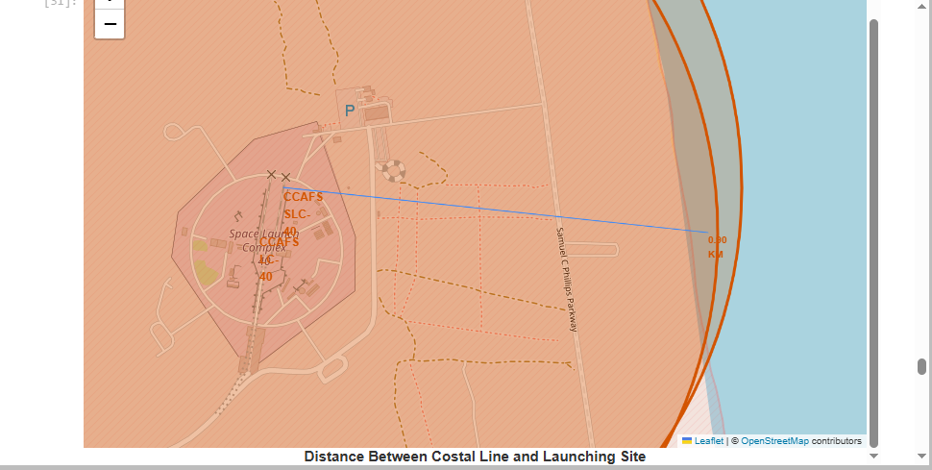
Distance between a Launch Site and Costal Line
The map shows the distance between CCAFS LC-40 launch site and the coastline.
Findings:
The distance is found to be .931 Km approximately.

Slide 43

Section 4

Slide 44
Total Success Launches by Site
KSC LC-39A had Much higher success percentage of 41.7 % of the total successful launches.

Slide 45
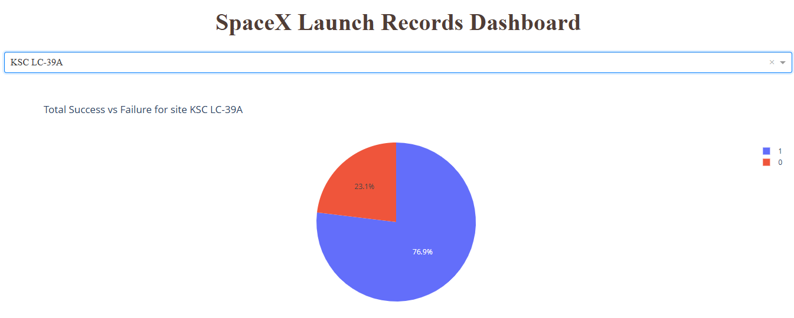
Total Success vs Failure for the Highest Launching Site
KSC LC-39A Had a relatively very high success percentage of 76.9% of the total launches.

Slide 46
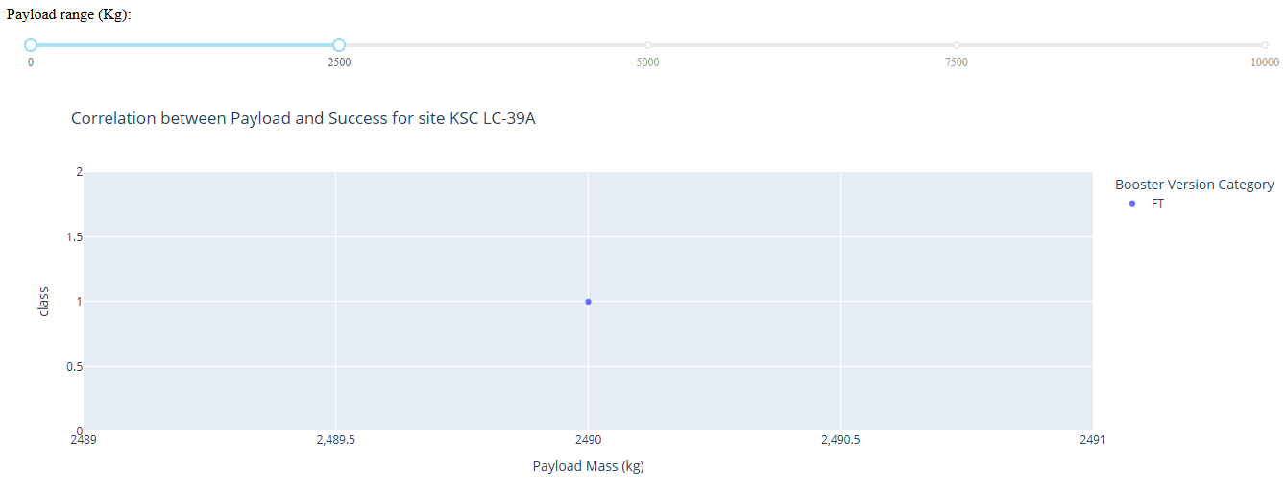
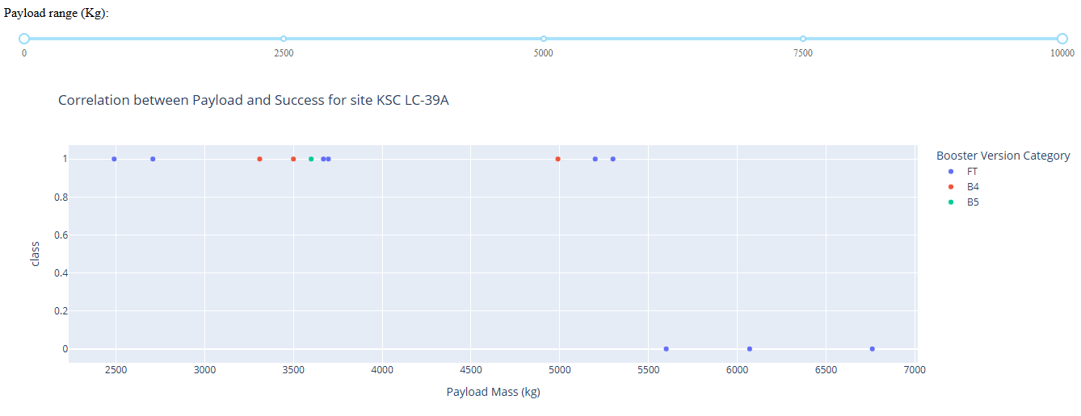
Payload vs. Launch Outcome for different ranges scatter plots

Slide 47
Payload vs. Launch Outcome for different ranges scatter plots
Booster version FT had the highest number successful launches.

Slide 48

Section 5

Slide 49
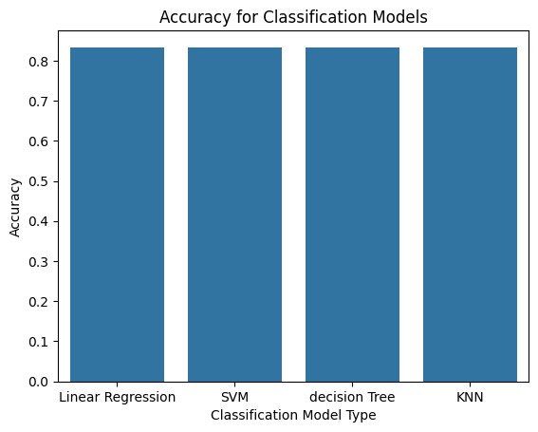
Classification Accuracy
All classification models performed exactly the same,which suggests that the dataset is small and has fewer values.

Slide 50

Confusion Matrix
All models performed exactly the same with the following confusion matrix data:
True Positive = 12
False Positive = 0
True Negative = 3
False Negative = 3
The confusion matrix suggests that the models are better for predicting positive outcomes. i.e. successful landing.

Slide 51
Conclusions
The project demonstrated how data-driven decision-making can support the prediction of Falcon 9 first stage landing outcomes.
Through exploratory data analysis (EDA), we found patterns linking payload mass, launch site, orbit type, and booster version to landing success.
Using machine learning models (Logistic Regression, Decision Tree, SVM, KNN), we achieved consistent performance with 83% accuracy, emphasising that the data size is insufficient.
Further analysis revealed that the models were better at predicting successful landings than failed ones, due to the insufficient data size.
This study highlights the importance of collecting sufficient datasets, advanced resampling, or alternative modeling approaches to improve predictive power for rare outcomes (failed landings).
Overall, the models show practical potential for SpaceX decision support — estimating the likelihood of first-stage recovery can help optimize costs and mission planning.

Slide 52
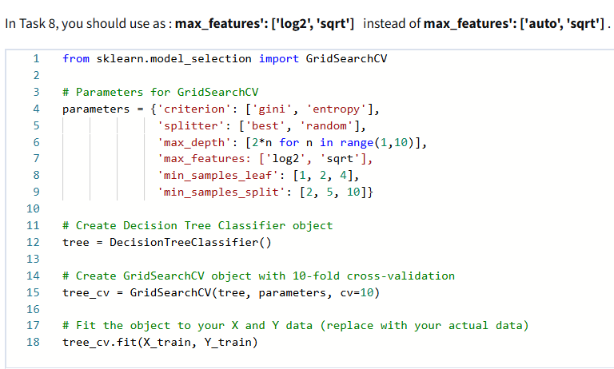
Appendix
Data Source: SpaceX API, Wikipedia
Tools: Python (pandas, numpy, matplotlib, seaborn, scikit-learn, plotly, folium)
Preprocessing: Cleaned data, encoded features, scaling
Models Tested: Logistic Regression, Decision Tree, SVM, KNN (GridSearchCV & cross-validation)
Limitations: Small, imbalanced dataset (more successes than failures)
Future Work: Use ensemble models (Random Forest, XGBoost), apply resampling (SMOTE), integrate weather/mission data

Slide 53


